Slide 1
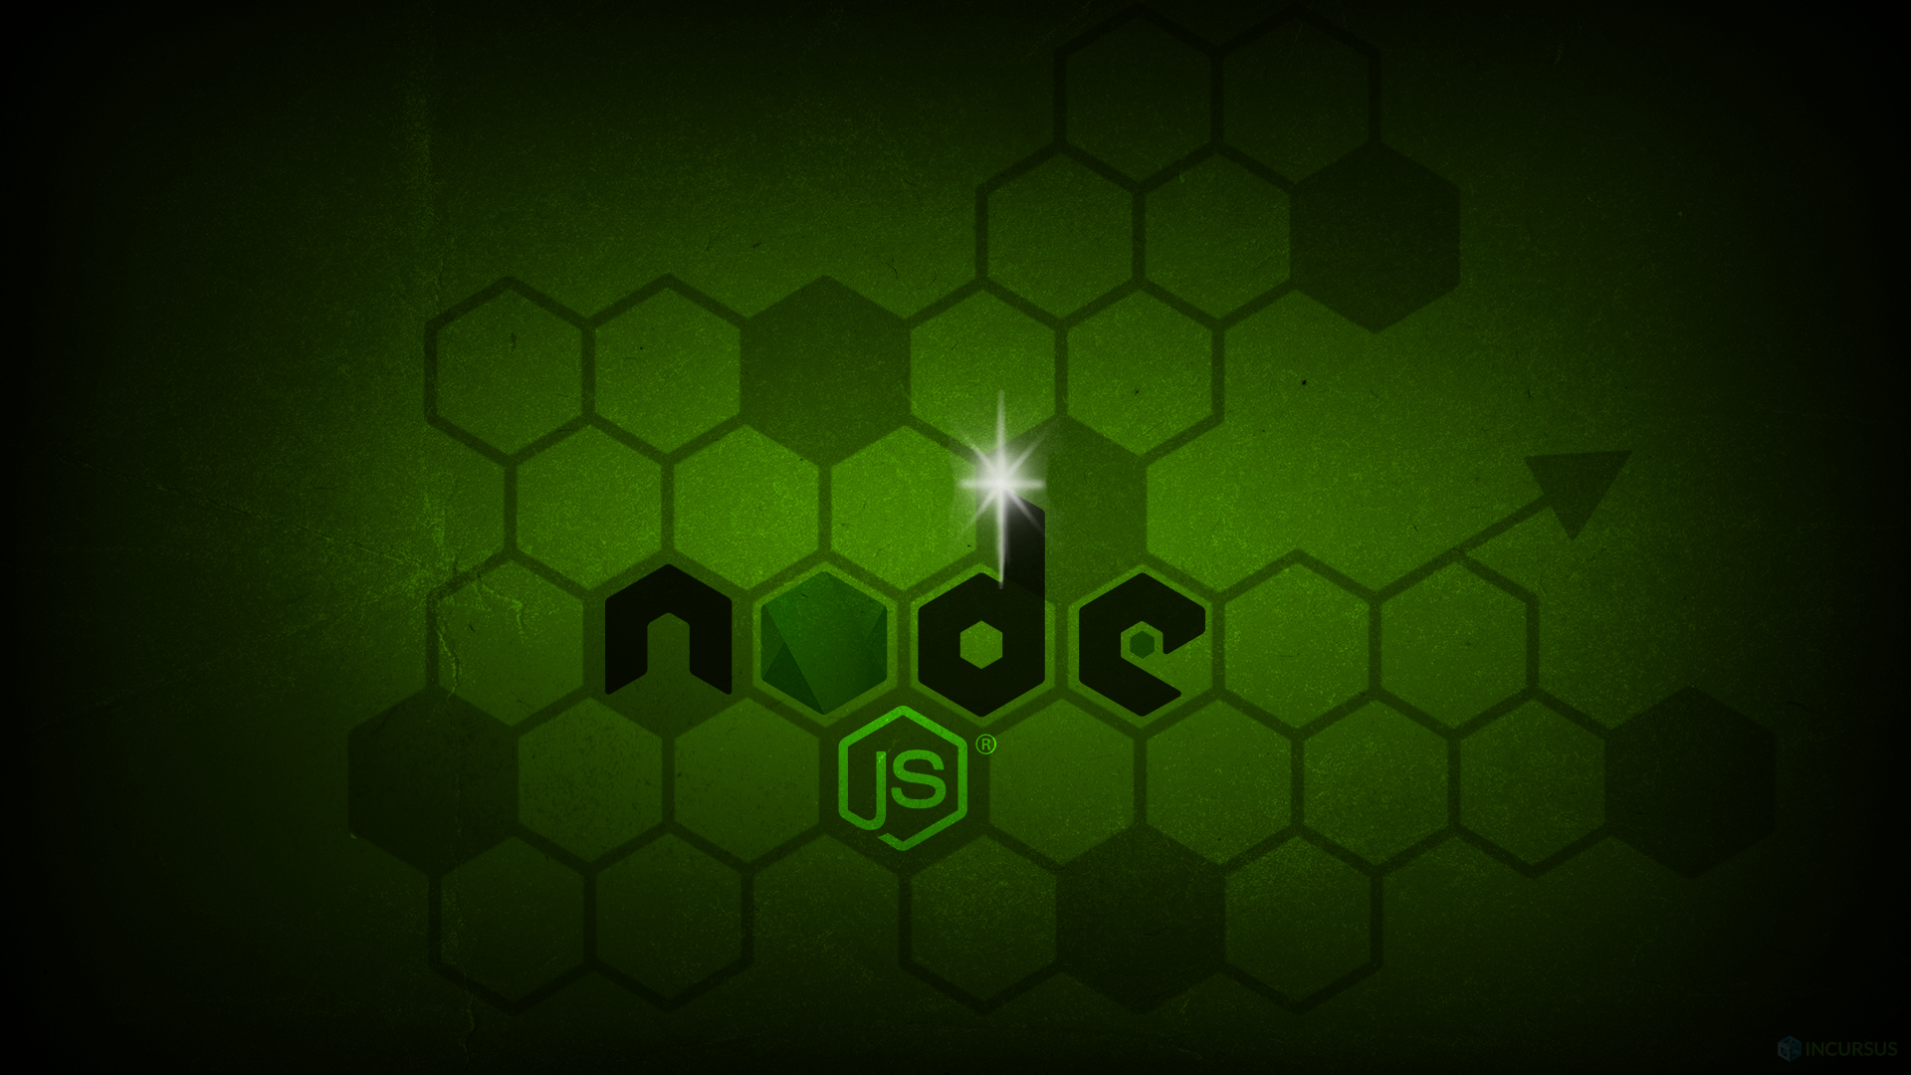
Presented By: Adeesh Singhai
Akash Mittal, Bhagyesh Gajre
Topic: An Overview Of Node JS
Submitted To: Upendra Singh Sir
Subject: Web Engineering (IT38504)

Slide 2
What is Node.js?
Node.js is a powerful JavaScript runtime built on the V8 JavaScript engine from Google Chrome. Unlike traditional JavaScript, which runs in web browsers, Node.js allows the execution of JavaScript code on servers.
Enables server-side JavaScript development.
Built on the fast and efficient V8 JavaScript engine.
Facilitates the execution of JavaScript code outside of web browsers.
Significance: Node.js has become a cornerstone technology, unifying server-side and client-side development under a single language, JavaScript
Node.js was created by Ryan Dahl. He introduced Node.js in 2009 as an open-source, cross-platform JavaScript runtime environment. Ryan Dahl's goal was to enable server-side programming using JavaScript, which was traditionally associated with client-side scripting in web browsers. Node.js brought JavaScript to the server-side, allowing developers to use a single programming language (JavaScript) for both client and server applications, which was a significant shift in the web development landscape.

Slide 3
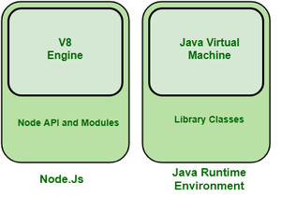
Explain V8 engine in Node.js
Node.js is a runtime environment that allows you to execute JavaScript code server-side. It is built on the V8 JavaScript engine, which is primarily written in C++. The V8 engine is developed by the Chromium project (the open-source project behind the Google Chrome browser), and it's responsible for executing JavaScript code in a high-performance manner.
Node.js itself provides additional functionality beyond the V8 engine, including a set of APIs for handling file systems, networking, and other server-side tasks. In essence, you can think of Node.js as a JavaScript runtime that leverages the V8 engine and provides a set of libraries to facilitate server-side development.
So, while it's not accurate to say Node.js is "a lot of C++ code wrapped with JS code," it is accurate to say that Node.js incorporates the V8 engine (written in C++) and extends it with JavaScript APIs to create a server-side runtime environment for JavaScript.

Slide 4
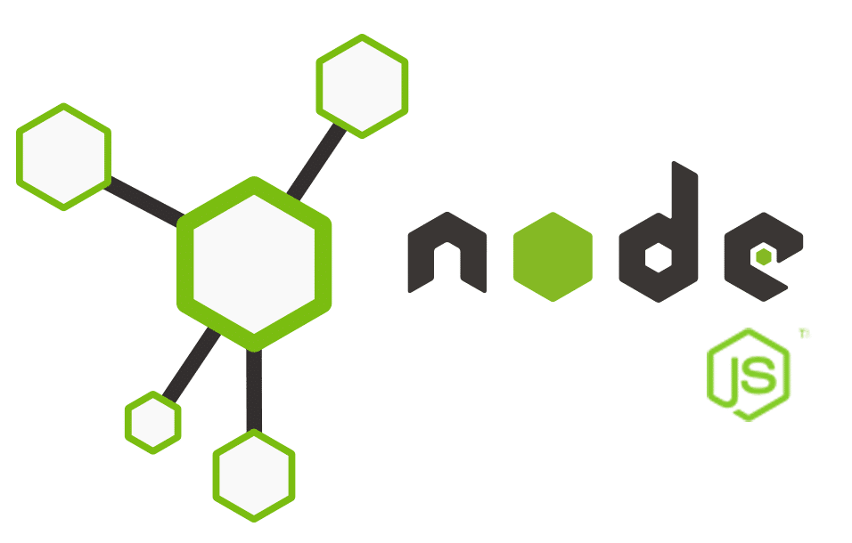
Getting Started with Node
1.Installation:
Node.js can be easily installed on various platforms, including Windows, macOS, and Linux.
Visit the official Node.js website (https://nodejs.org) to download the installer for your operating system.
2. Setting Up a Project:
Initialize a Node.js project using the command: npm init.
This creates a package.json file, which contains project metadata and dependencies.
3. Basic Commands:
Use npm install to install project dependencies listed in the package.json.
Execute a Node.js script with the node command, followed by the script's filename.

Slide 5
Why do we need Node JS?
Node.js is a JavaScript runtime built on Chrome's V8 JavaScript engine. It allows you to run JavaScript on the server side, outside of a web browser. Here are some reasons why Node.js is widely used and how it differs from client-side JavaScript:
Server-Side Development: One of the main use cases for Node.js is server-side development. Traditionally, JavaScript was primarily used for client-side scripting in web browsers. With Node.js, developers can use JavaScript to build scalable and efficient server-side applications, allowing for a unified language and ecosystem across both client and server.
Non-blocking I/O: Node.js is designed to be non-blocking and event-driven. This means that it can handle many concurrent connections without waiting for one operation to complete before moving on to the next. This makes it well-suited for building real-time applications like chat applications, online gaming, and collaborative tools.
NPM (Node Package Manager): Node.js comes with a powerful package manager, NPM, which allows developers to easily manage and share packages (libraries and tools). The vast NPM ecosystem includes a wide range of modules that can be easily integrated into Node.js applications, saving development time and effort.

Slide 6
JavaScript Everywhere: Using Node.js enables developers to use JavaScript throughout the entire application stack, from server to client. This can lead to improved code sharing, easier maintenance, and a more consistent development experience.
Community and Ecosystem: Node.js has a large and active community, contributing to a vibrant ecosystem of libraries and frameworks. This rich ecosystem makes it easier for developers to find solutions to common problems and accelerates development by providing pre-built modules for various functionalities.
Scalability: Node.js is known for its ability to handle a large number of simultaneous connections with high throughput. This makes it well-suited for building scalable network applications, especially those that require real-time features.
Cross-Platform Development: Node.js applications can run on various operating systems, including Windows, macOS, and Linux. This cross-platform compatibility simplifies development and deployment processes.
While Node.js shares the JavaScript language with client-side development, it is designed for a different environment and use cases. Node.js focuses on server-side development, emphasizing scalability, performance, and efficient handling of concurrent connections. It complements client-side JavaScript and extends the capabilities of the language beyond the browser.

Slide 7
Node JS Ecosystem
Node.js Core Modules:
Node.js provides a set of core modules for handling various tasks, such as file system operations, networking, and more. These modules include fs (File System), http (HTTP server/client), net (TCP server/client), and events (EventEmitter), among others.
npm (Node Package Manager):
npm is the default package manager for Node.js. It allows developers to easily install, share, and manage dependencies for their projects. The npm registry hosts a vast collection of open-source packages that developers can include in their applications.
Express.js:
Express.js is a popular web application framework for Node.js. It simplifies the process of building robust and scalable web applications by providing a minimalistic and flexible set of features. It is widely used for creating APIs and web applications.
Frontend Frameworks:
Node.js is often used in combination with frontend frameworks like React, Angular, or Vue.js. Tools like Next.js and Nuxt.js leverage Node.js for server-side rendering and building universal web applications.
Database Connectivity:
Node.js supports various databases, both SQL and NoSQL. Popular libraries include mongoose for MongoDB, sequelize for SQL databases, and redis for Redis.

Slide 8
WebSocket Libraries:
Libraries like Socket.io enable real-time communication between clients and servers using WebSockets, making it easier to build interactive and dynamic applications
7.Serverless Computing:
With platforms like AWS Lambda, Azure Functions, and Google Cloud Functions, Node.js is widely used for serverless computing, allowing developers to run code without managing servers.
8.Community and Events:
The Node.js community is active, with regular conferences and meetups around the world. Node.js Interactive, NodeConf, and NodeSummit are examples of events that bring together Node.js developers.

Slide 9
Event Driven Programming in Node JS
Client Makes a Request:
A client (e.g., a web browser) sends a request to the Node.js server.
Event Queue:
The server's event queue receives the incoming request as an event.
Event Loop:
The event loop continuously checks the event queue for new events.
Checking Type of Operation:
When an event is pulled from the queue, the event loop checks the type of operation associated with it.
Non-Blocking Operation:
If the operation is non-blocking (e.g., an asynchronous I/O operation or a timer), the event loop initiates that operation and moves on to the next event in the queue without waiting for the non-blocking operation to complete.
Meanwhile, the server remains responsive and can handle other incoming requests or events.
Callback Execution:
Once the non-blocking operation is completed, its callback is placed in the callback queue.

Slide 10
Event Loop Checks Callback Queue:
The event loop periodically checks the callback queue for completed non-blocking operations.
Callback Execution (Continued):
If there are callbacks in the queue, the event loop executes them one by one in the order they were added.
Blocking Operation:
If the operation is blocking (e.g., a CPU-intensive computation), the event loop might delegate the task to a worker thread or an external process to avoid blocking the main event loop.
This allows the event loop to continue processing other events and requests while the blocking operation is being handled separately.
Worker Threads (if applicable):
If Node.js is configured to use worker threads, the blocking operation may be offloaded to a separate thread to prevent it from affecting the main event loop's responsiveness.
Completion of Request:
The entire process repeats for each incoming request, allowing Node.js to handle a large number of concurrent connections efficiently.
In summary, Node.js uses an event-driven, non-blocking architecture to handle client requests. Non-blocking operations are initiated and then processed asynchronously when completed, while blocking operations may be offloaded to separate threads or processes to maintain the responsiveness of the main event loop. This design allows Node.js to scale and handle a large number of concurrent connections without the need for extensive multithreading.

Slide 11
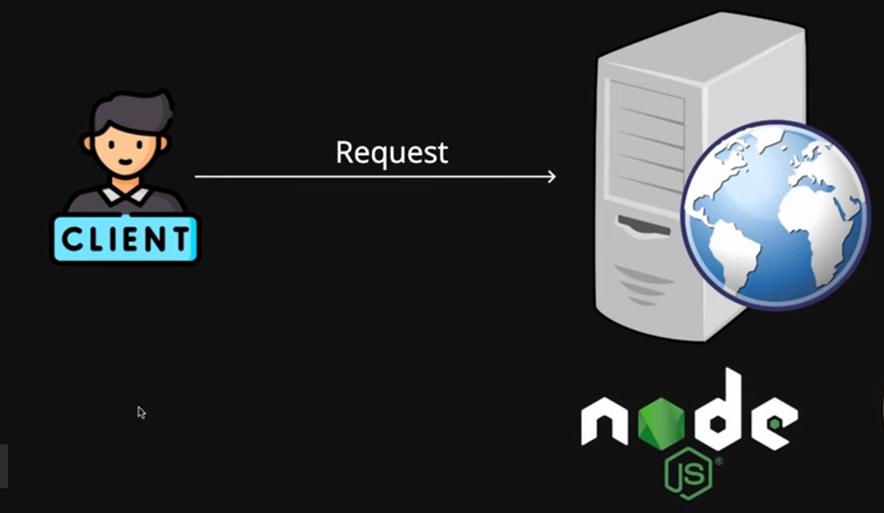
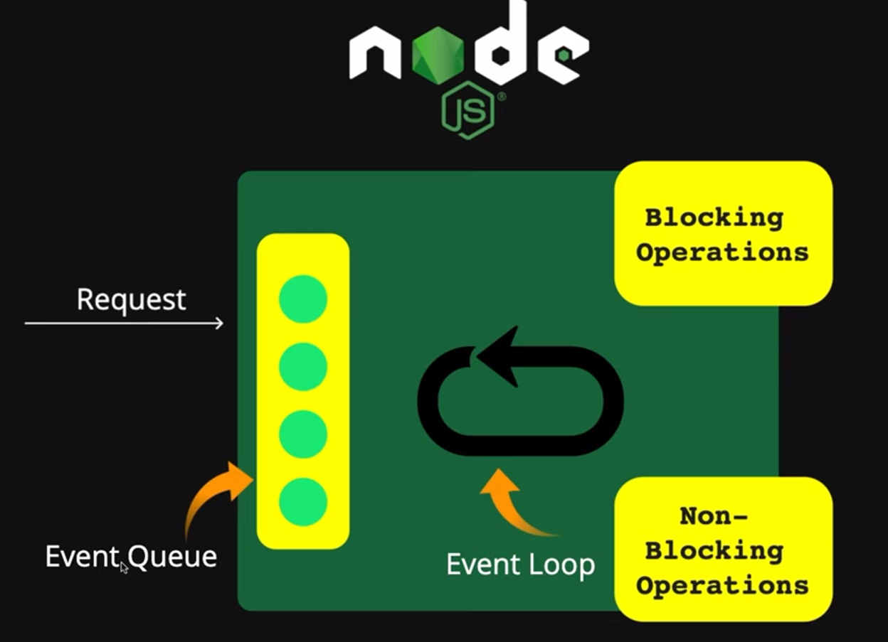
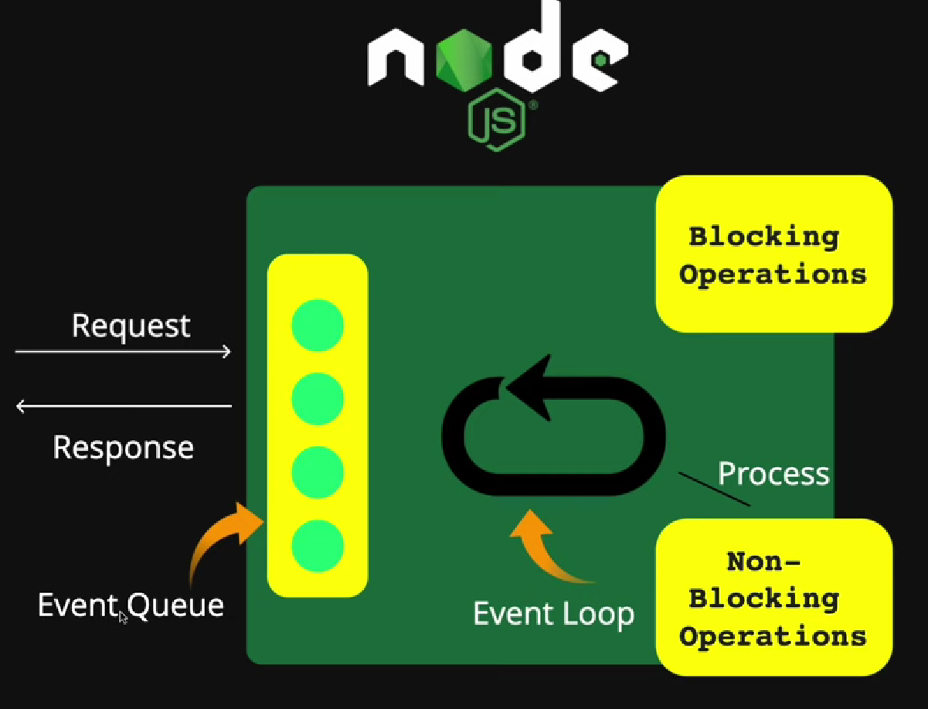
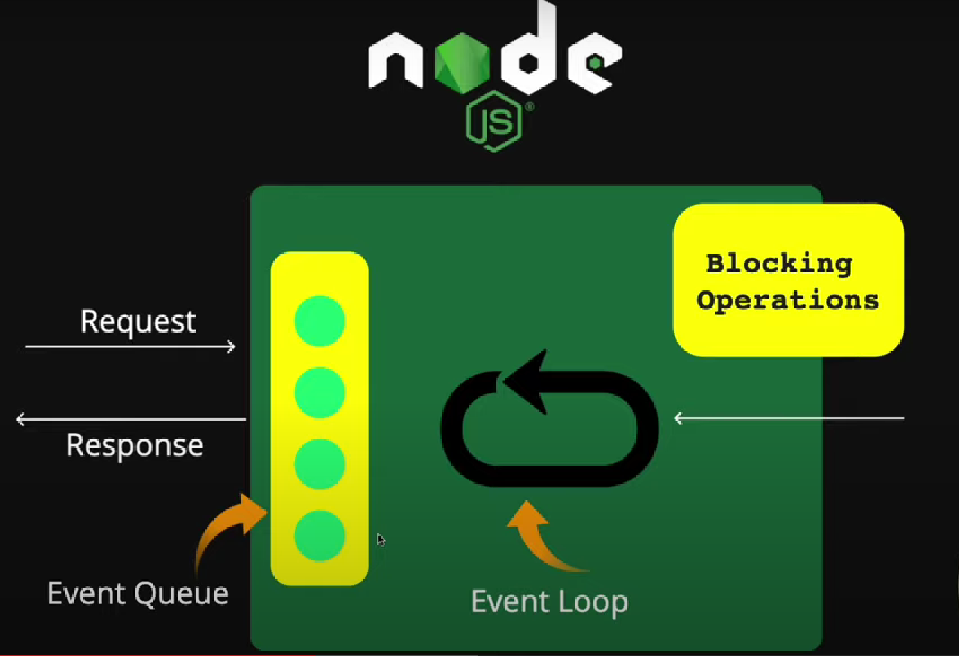
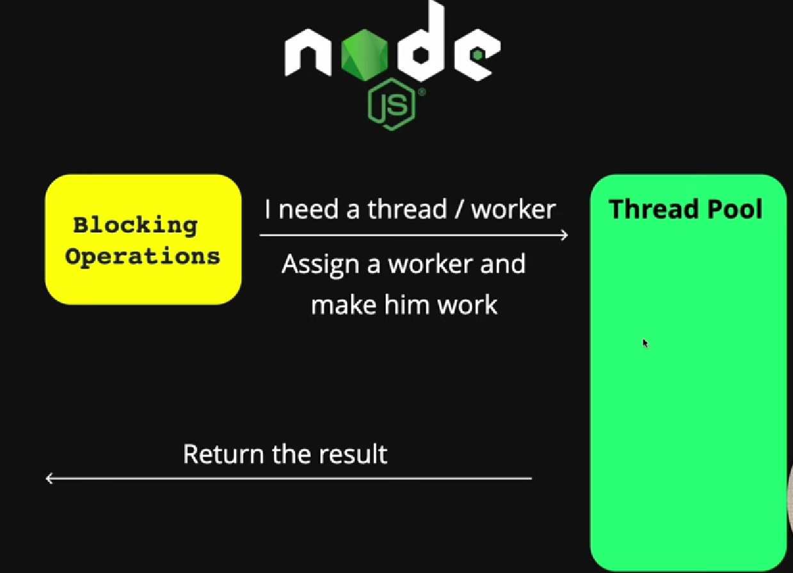
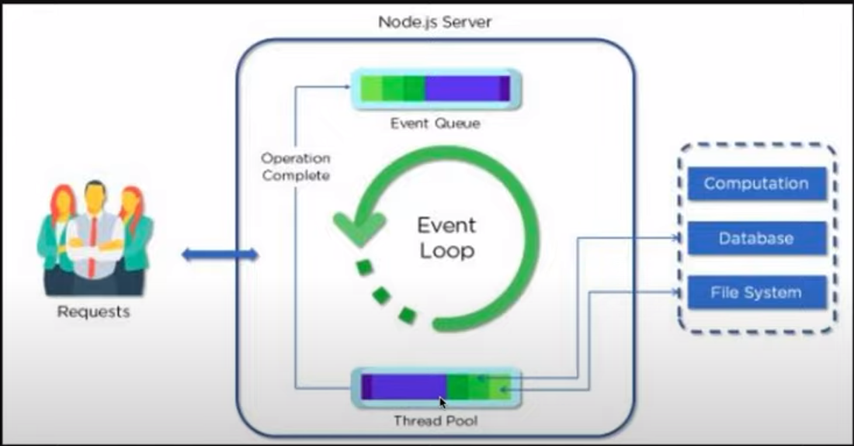
Client makes a request
Event queue receives the requests and places all in a queue
Event loop checks whether the operation is blocking or non blocking
In case of non blocking operation the loop processes the request and sends the response
In case of Blocking operation the loop assigns a thread and make him work
It’s a good practice to always write your code using non blocking operations to avoid scalability issues

Slide 12
Advantages
Scalability:
Node.js is well-suited for building scalable network applications. Its event-driven architecture allows handling a large number of concurrent connections efficiently.
High Performance:
The V8 JavaScript engine, combined with non-blocking I/O, enables high performance by executing JavaScript code in a fast and optimized manner.
Fast Execution:
Node.js is designed to be lightweight and efficient, which results in fast execution of code.
Single Programming Language:
Using JavaScript on both the client and server sides reduces the need for context switching and allows for better code reuse.
Large Ecosystem (NPM):
Node Package Manager (NPM) provides a vast ecosystem of open-source libraries and tools, making it easy for developers to find and use existing packages.
Community Support:
Node.js has a large and active community, contributing to its ongoing development, providing support, and sharing knowledge.

Slide 13
Asynchronous and Non-blocking:
Node.js uses an event-driven, non-blocking I/O model, allowing for the efficient handling of concurrent requests without creating many threads or processes.
Real-time Capabilities:
Node.js is well-suited for real-time applications such as chat applications, online gaming, and collaborative tools due to its ability to handle multiple connections simultaneously.
Cross-Platform Compatibility:
Node.js is designed to be cross-platform, allowing developers to build applications that run on various operating systems with minimal modifications.

Slide 14
NPM is the default package manager for Node.js, facilitating the installation, sharing, and management of JavaScript packages and libraries.
Package Installation:
Use npm install <package-name> to install packages. This command reads the package.json file to determine dependencies.
Dependency Management:
npm automatically manages project dependencies and versions by updating the package.json file.
Global vs. Local Packages:
Global packages are installed system-wide (npm install -g), while local packages are specific to a project.
Scripts and Commands:
npm allows you to define scripts in the package.json file, which can be executed using npm run <script-name>.
Publishing Packages:
Developers can publish their own packages to the npm registry, making them available for others to use.
Why npm Matters:
npm is a crucial part of the Node.js ecosystem, providing a vast collection of open-source libraries and tools that enhance development productivity.
Tips:
Regularly update npm (npm install -g npm) to benefit from the latest features and security updates.
Node Package Manager (npm)

Slide 15
Create a Simple HTTP Server Using Node JS
const http = require('http'); http.createServer((req, resp)=>{ resp.write("<h1> Hello, EveryOne </h1>");
resp.end();
}).listen(4500);
Importing the http module:
const http = require('http');
This line imports the built-in Node.js http module, which provides functionality for creating HTTP servers and handling HTTP requests and responses.
Creating an HTTP server:
http.createServer((req, resp) => { // Code to handle incoming requests }).listen(4500);
http.createServer((req, resp) => {...}): This function creates an HTTP server. It takes a callback function with two parameters: req (the incoming request) and resp (the server response).
.listen(4500): This method makes the server start listening on port 4500 for incoming requests.
Request handler:
(req, resp) => { resp.write("<h1> Hello, EveryOne </h1>"); resp.end(); }
The callback function specified in createServer is responsible for handling each incoming HTTP request. In this case:
resp.write("<h1> Hello, Buddies </h1>");: Writes the HTML content with the heading "Hello, Buddies" to the response.
resp.end();: Signals the end of the response. This is necessary to send the response back to the client.
Listening on port 4500:
.listen(4500);

Slide 16
Create a Simple Express JS Server
const express = require('express');
const path = require('path’);
const app = express();
// This line creates an instance of the Express application, which will be used to configure and run the server.
const port = 3000;
// This line defines the port number on which the server will listen for incoming requests. In this case, the server will run on port 3000.
app.use(express.static(path.join(__dirname, 'public')));
// The code imports the express module, which is a popular web framework for Node.js, and the path module, which provides utilities for working with file and directory paths.
// The express.static middleware is used to serve static files such as images, CSS files, and JavaScript files. Here, it's configured to serve files from the "public" directory. The path.join(__dirname, 'public') constructs the absolute path to the "public" directory

Slide 17
app.get('/', (req, res) => {
res.sendFile(path.join(__dirname, 'public', 'index.html'));
});
This code sets up a route for the root URL ("/"). When a client makes a GET request to the root URL, the server responds by sending the index.html file located in the "public" directory
app.listen(port, () => {
console.log(`Server is running at http://localhost:${port}`);
});
This line starts the server and makes it listen on the specified port. The callback function is executed once the server is successfully started and prints a message to the console indicating the server's address.
.
In summary, this code sets up a basic Express server that serves static files from the "public" directory and handles a route for the root URL by sending the index.html file. You can add more routes and server-side logic as needed for your project.

Slide 18
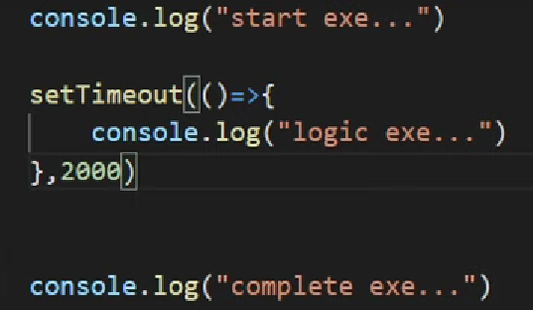
Conclusion
Key Takeaways:
Node.js enables server-side JavaScript, unifying development languages and promoting code reuse.
Its asynchronous, event-driven model makes it well-suited for scalable and responsive applications.
The npm ecosystem, along with frameworks like Express.js, empowers developers to build robust and feature-rich applications.
Real-time capabilities with technologies like Socket.io open up new possibilities for interactive and collaborative applications.
Best practices ensure the development of efficient, scalable, and maintainable Node.js applications.

Slide 19
Who developed node js first and how it was developed?
How does Node.js leverage the V8 engine?
What are some aspects where Node.js, running on the server side, differs from client-side JavaScript?
What is advised for best practices writing code using blocking or non blocking operations?Why?
What are few alternatives to node js and what are its advantages?

Slide 20
Thank you…
Have a nice Day

